Slide 1
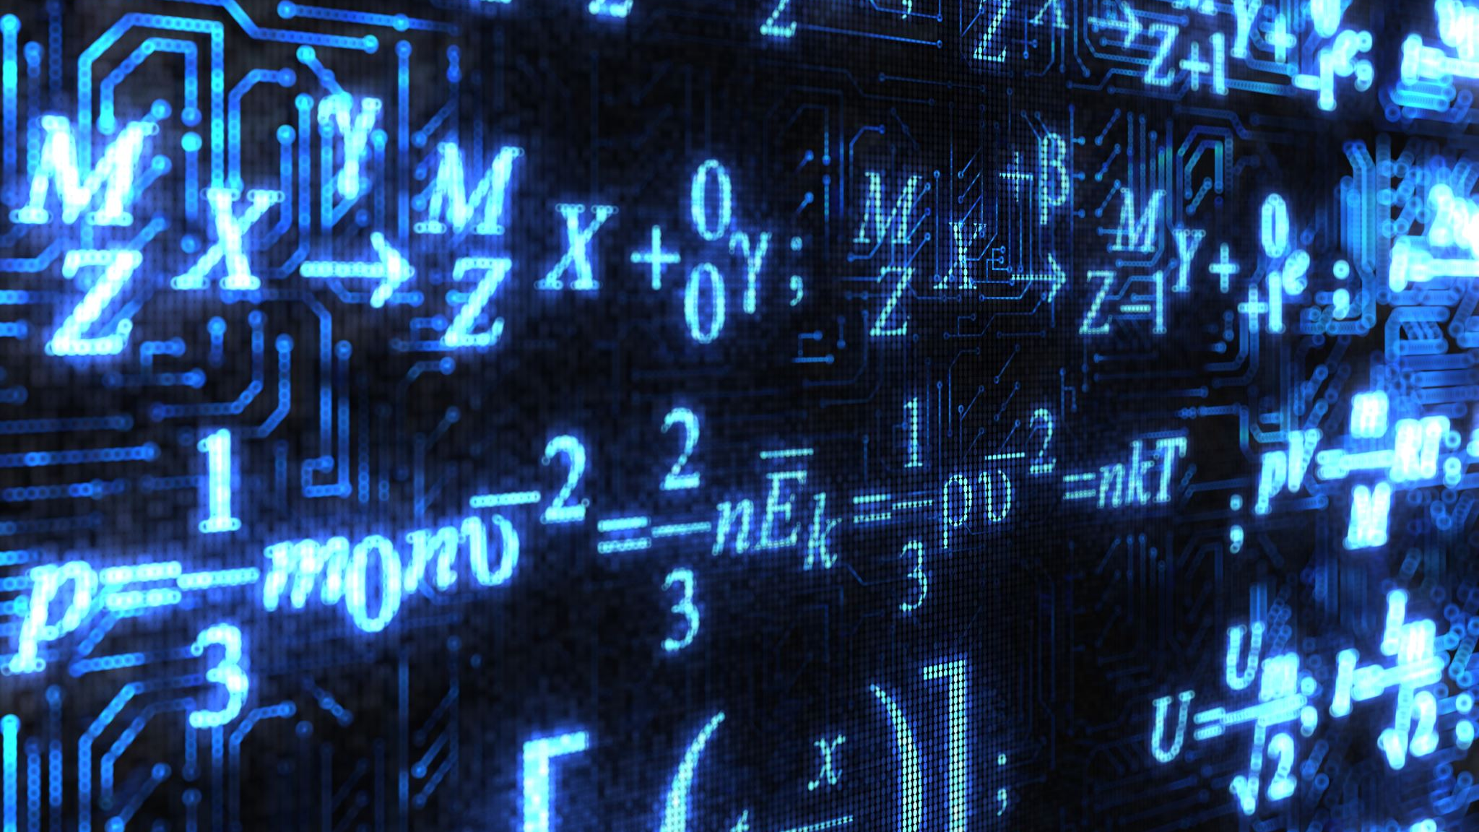
Why Math?
By Ariel Avshalom
Introductory Lecture
CISC 2210

Slide 2
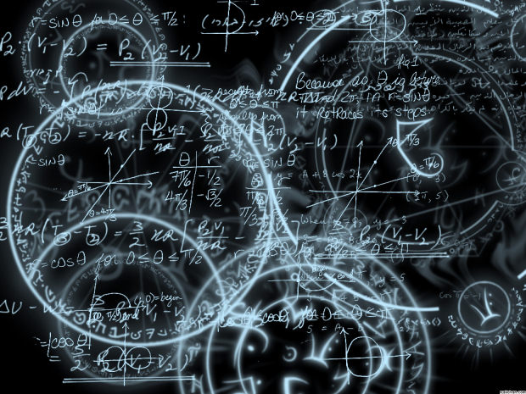
What is Mathematics?
Just like we use words to communicate, mathematics is the language of the universe.
We discover and present the secrets of our world through the language of math.
There are 2 main branches of mathematics:
Discrete Math
Continuous Math
Notes:
It is a precise way to define and abstract concepts which we see in the real world.

Slide 3

What is Continuous Mathematics
We will not cover continuous mathematics in this course
In short, continuous mathematics covers the study of the infinite between two values.
There is no distinct object, everything blends together.
Notes:
We will briefly talk about this in our set theory unit

Slide 4

Discrete Mathematics
There is no precise definition, but it is the study of distinct countable objects.
The best way to define it by what it excludes, namely continuously varying quantities.

Slide 5
What we’ll cover
Set Theory
Logic
Proofs
Counting
Probability Theory
*Graph Theory
*Algorithms and complexity
Notes:
The starred categories will be covered if time permits.

Slide 6
Grading

Slide 7

Notes on grading
There will be 5 quizzes and 1 will be dropped. Each is worth 5 points
The final is worth 30 points
The midterm is worth 25 points
Participation is worth 10 points
Homework is worth 15 points
The homework will not be graded. You’ll automatically receive 15 points
The exams and quizzes will be heavily based on the homework
There are solutions posted at the end of each chapter.

Slide 8
The textbook
While I’ve assigned a textbook for this course, it is not required. It’s a very neat book and it is written well so if you’re interested in studying more discrete math you’re welcome to use it as well.
The other book I assigned (The Computational Beauty of Nature) is a great read and it’ll really give you the motivation for studying math.
The book we will use in this course is free and online. Homework and reading will be assigned from there and it available here:
https://www.people.vcu.edu/~rhammack/Discrete/Alpha.pdf

Slide 9
Extra credit may be assigned
This is a CS course and while math is super important in CS (it gave birth the field), some CS notions will also be covered.
These concepts will be given as extra credit when time permits.
I’ll collect these and try to cover them in class.
The value of the extra credit will be determined when it is assigned.

Slide 10
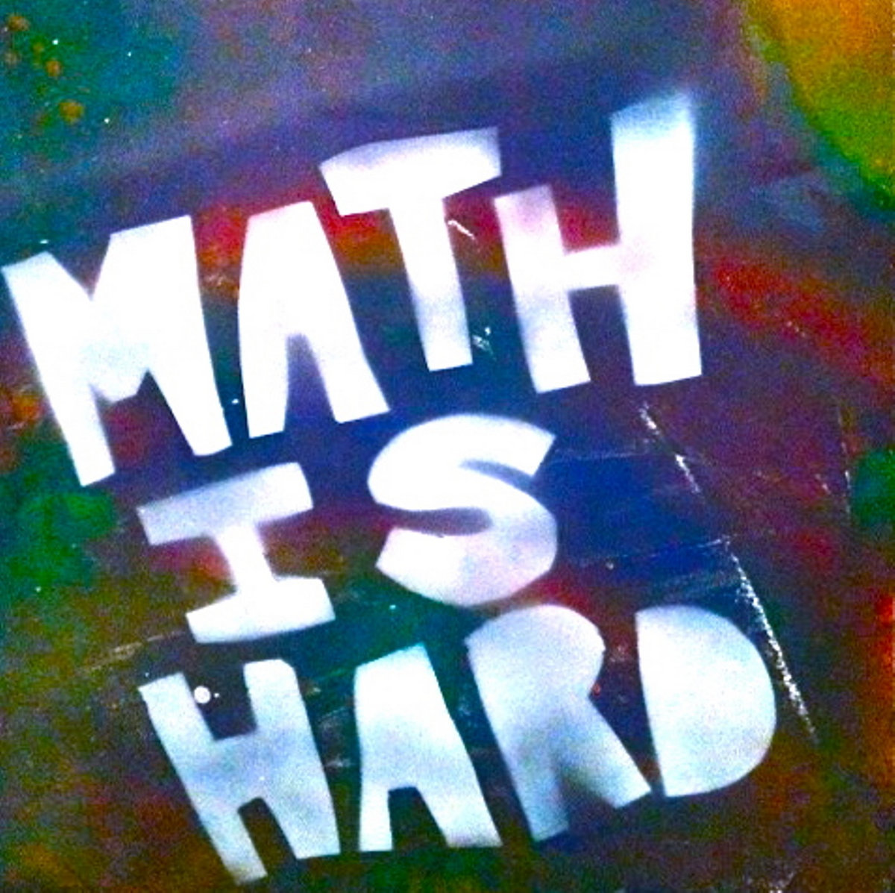
Math is hard
The idea that it comes naturally to people is an old wives’ tale.
Humans are naturally illogical and math is nothing if not logical.
That being said, I’ll give it my best to make this course interesting and meaningful.
My hope is that you try to do your best and that you learn something meaningful.

Slide 11
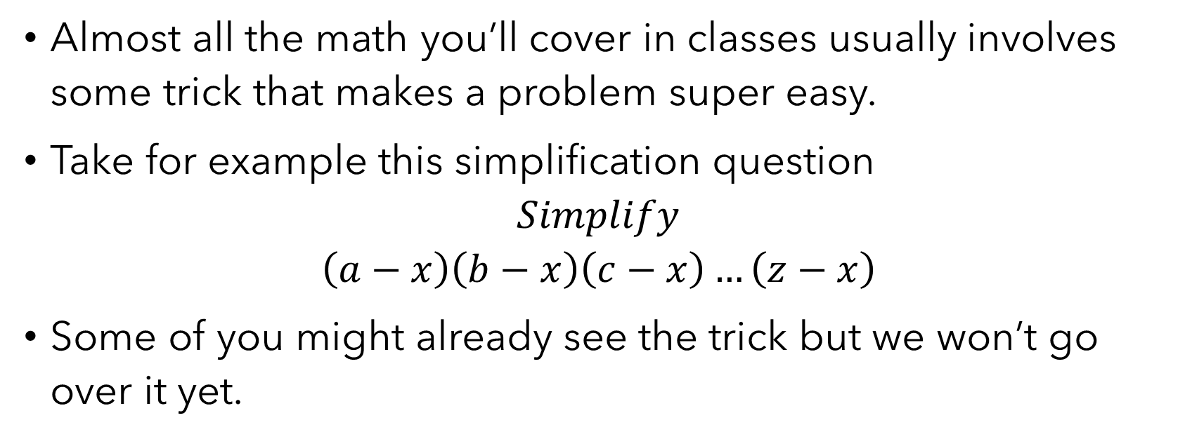
Pro Tip
Almost all the math you’ll cover in classes usually involves some trick that makes a problem super easy.
Take for example this simplification question
$$Simplify$$
$$\left(a−x\right)\left(b−x\right)\left(c−x\right)…\left(z−x\right)$$
Some of you might already see the trick but we won’t go over it yet.

